Slide 1
Pilgrimages

Slide 2
What is a Journey?

Slide 3
Definition
What is a
Pilgrimage?
‘A special journey made by a pilgrim’
‘a visit to a place that is considered special, where you go to show your respect’
Cambridge Dictionary

Slide 4
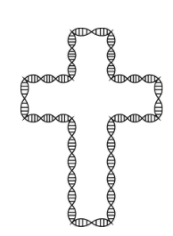
What is a Pilgrimage?
For Christians a pilgrimage means a journey that has religious or spiritual significance.
A person on a pilgrimage is called a pilgrim.
There are many reasons for someone to take a pilgrimage including:
Deepen their connection with God
Learning about historical places relating to Christianity
Seeking blessings and healings

Slide 5
Types of Pilgrimage
Pilgrimages can be different for different people. There are three key types of Pilgrimage a Christian might take.
Moral Pilgrimage
Place Pilgrimage
interior Pilgrimage
This is the serving of God and others throughout daily life.
The physical journey to holy sites and places.
The use of prayer and meditation for an inner spiritual journey with Christianity.

Slide 6
Where could you go on a pilgrimage?
The first Christian pilgrimages were related to sites connected to the birth, life, crucifixion and resurrection of Jesus. These are from stories in the New Testament.
In the 4th Century. Emperor of Rome, Constantine was the first Roman emperor to convert to Christianity and stopped the persecution of Christians in the 4th Century.
His Mother, Helena was thought to be a key person in making pilgrimages popular. She travelled to the Holy Land where she was said to have discovered the Holy cross.
Pilgrimage sites were also connected to places related to Saints and Miracles. These sites usually had relics, either remains of a saint or an object they owned.

Slide 7
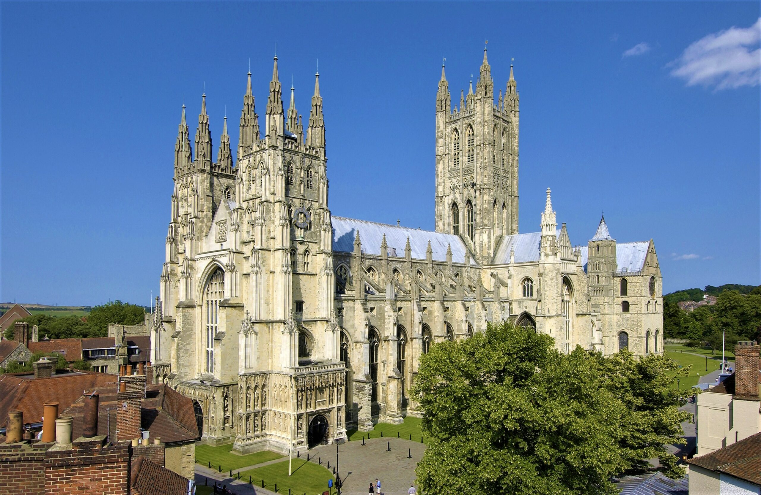
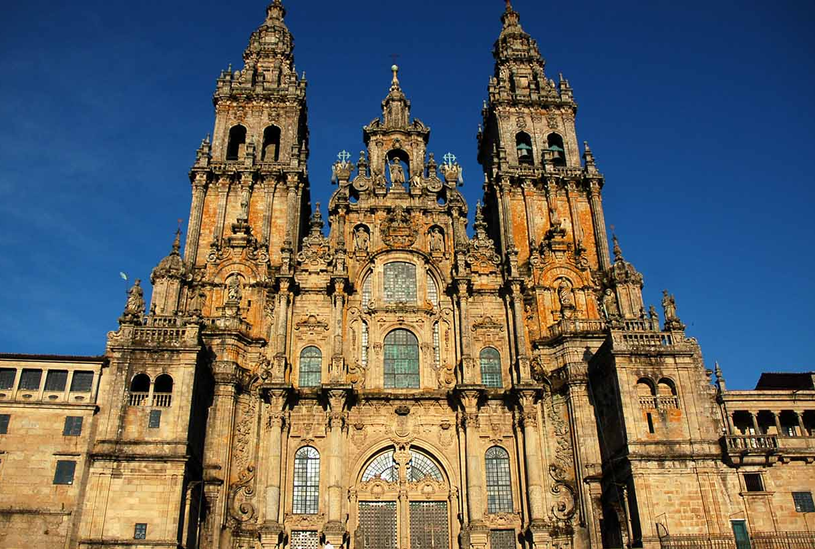
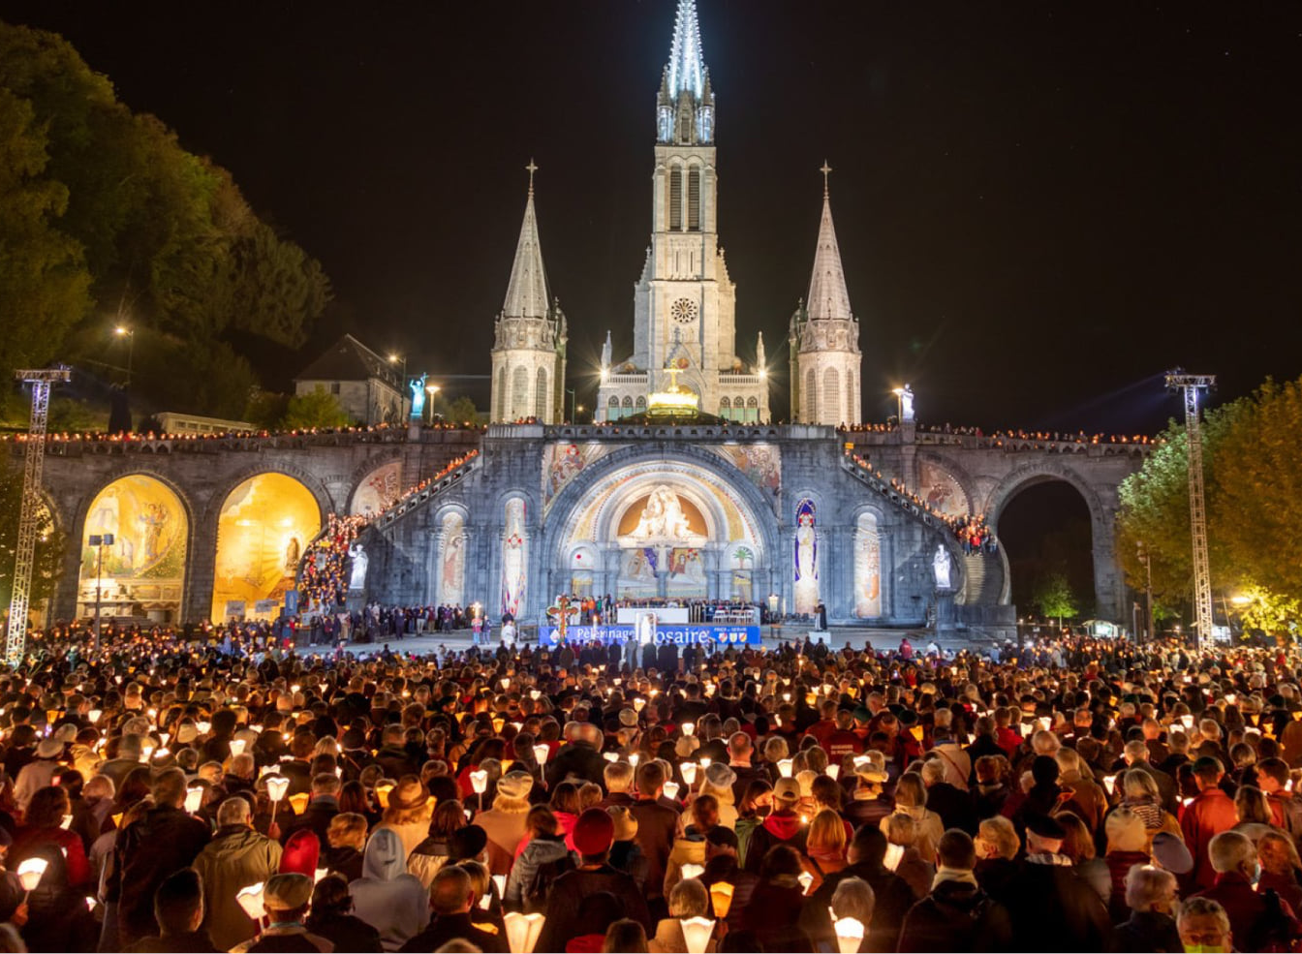
Popular pilgrim places
Canterbury Cathedral
England
Santiago de Compostela Cathedral
Spain
Lourdes
France

Slide 8
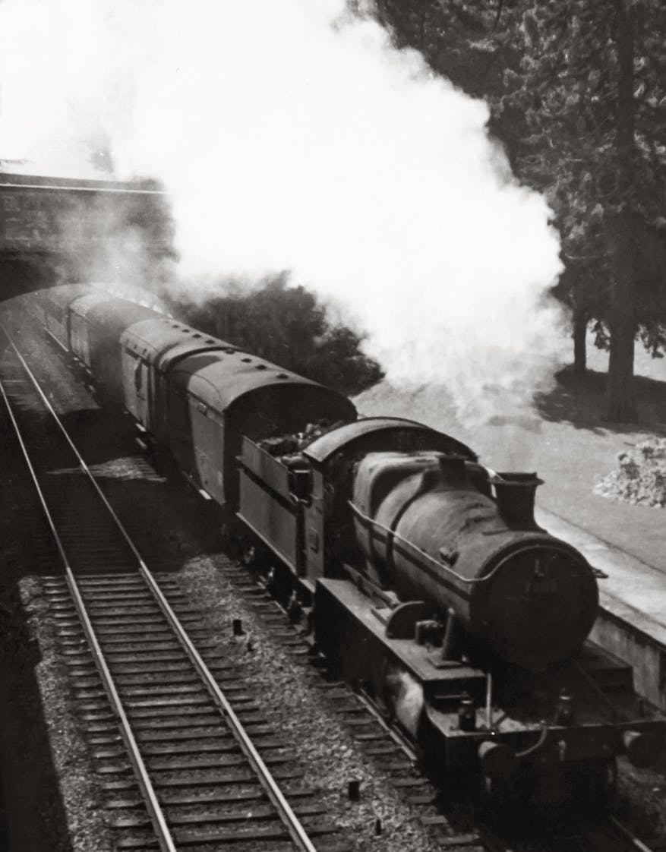
Pilgrimages through time
16th Century- The Reformation
- Martin Luther, a key figure in the protestant reformation, questioned the value of pilgrimages by suggesting that having ‘Holy places’ devalued other locations such as the parish church. An argument against place pilgrimages was:
If God is everywhere, how can there be places where he is more present?
19th Century- The railway is invented
New modes of transport meant people could travel quicker amongst places.
Tourism became popular.

Slide 9
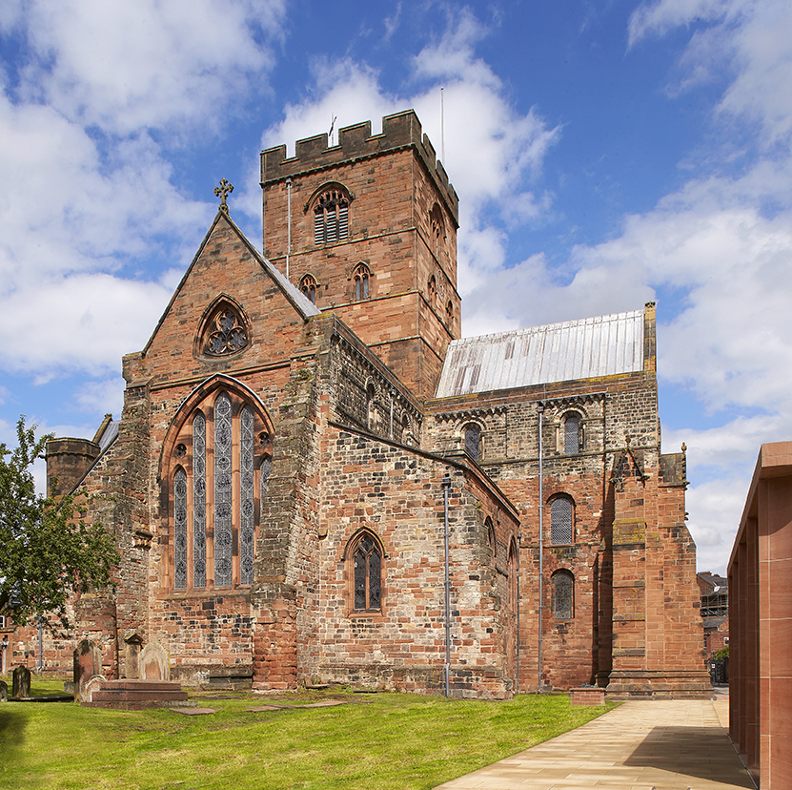
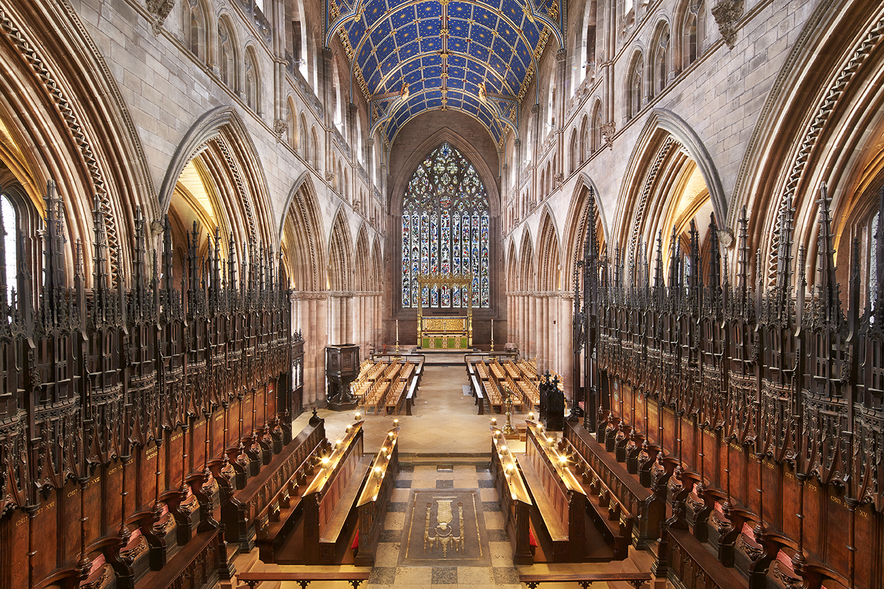
Cathedrals and Pilgrimage
Cathedrals today are still visited as a form of pilgrimage.
Visiting the Cathedral can be a historical, cultural and a spiritual experience.
140,000 people on average visit Carlisle Cathedral in a year.

Slide 10
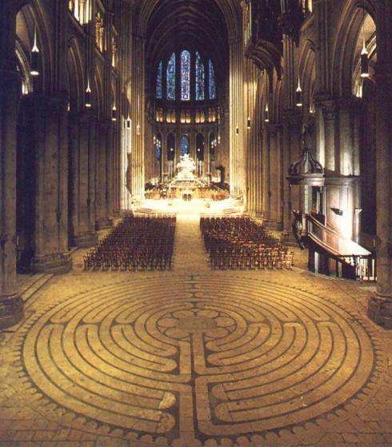
Labyrinths
Labyrinths have been used in many cultures throughout history. The first Christian example of a Labyrinth was in a church in 4th Century Algeria.
Unlike a maze, a labyrinth has one entrance and one route to and from the centre.
Labyrinths were used as a substitute to pilgrimage, especially for those who were unable to make the long and often dangerous journeys to holy sites around the world.

Slide 11
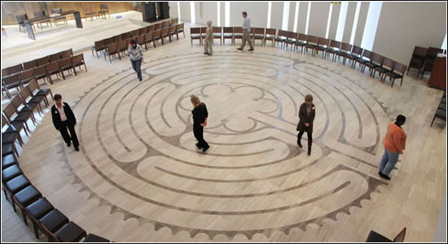
Labyrinths
The labyrinth can symbolise a Christians pilgrimage throughout their faith and their journey to God. People walk labyrinths for many different reasons for example as a space for prayer, self-reflection or reducing stress.
Walking a labyrinth is sometimes described as walking the ‘inward-outward’ path.

Slide 12
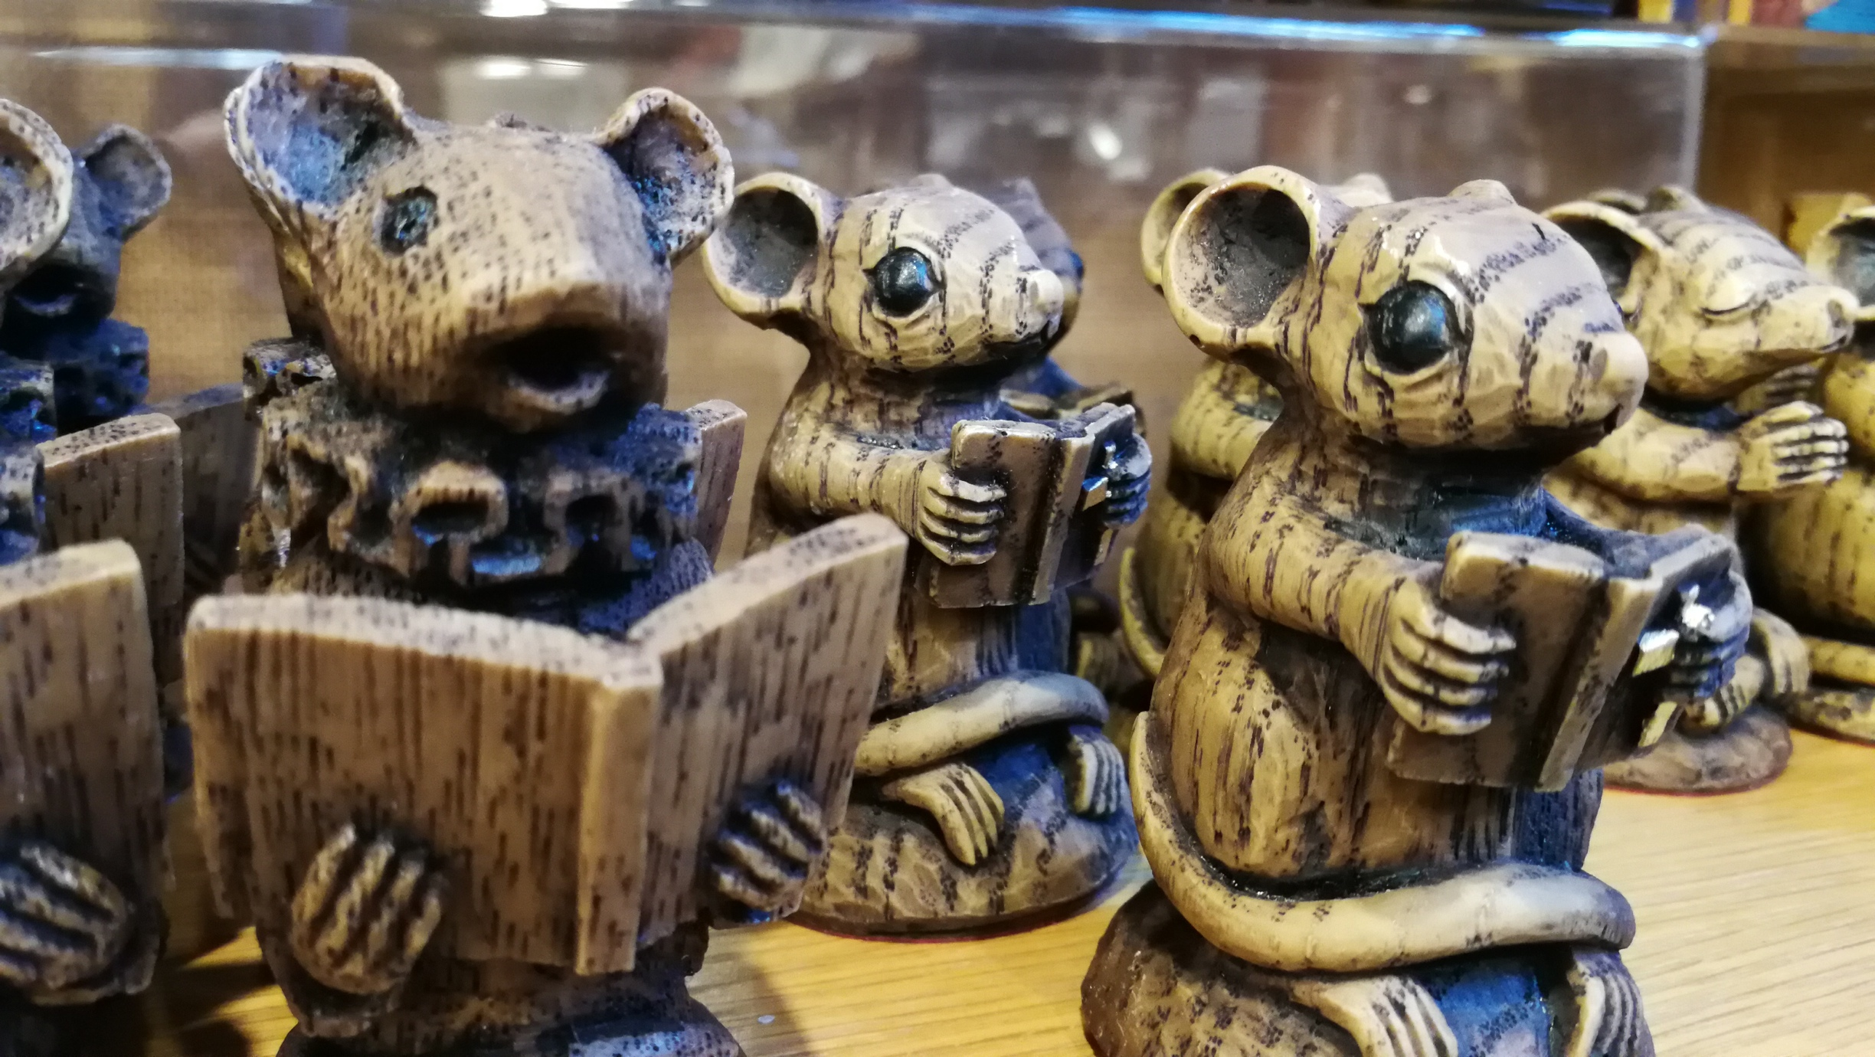
Do you buy souvenirs when you go on holiday?

Slide 13
St James
Apostle James, travelled to Spain to convert people to Christianity. Upon his return in 44AD he was killed by King Herod, making him one of the first Christian martyrs.
The scallop shell became the symbol of his journey to Spain and became a common symbol of pilgrims and pilgrimages.
© British Museum

Slide 14
A pilgrim badge would be unique and recognisable to each site. Pilgrims would wear their badges on their clothes or hats along their journeys.
Pilgrim Badges
Pilgrims upon visiting sites would take a small souvenir such as a stone from the buildings or a shell found near the sites.
With pilgrimages becoming more popular this became a problem for sites loosing parts of their buildings.
Pilgrim badges were created as a way of preventing sites being damaged or lost and a way for people near the site to make money from pilgrims.

Slide 15
Pilgrimage Routes

Slide 16
Cumbrian Cistercian Way
From Piel Castle (Barrow-in-Furness) to Cartmel Priory.
Walking distance: 25 miles

Slide 17
St Bega’s Way
From St Bees to St Bega (Bassenthwaite, Cumbria)
Walking distance: 36 miles.

Slide 18
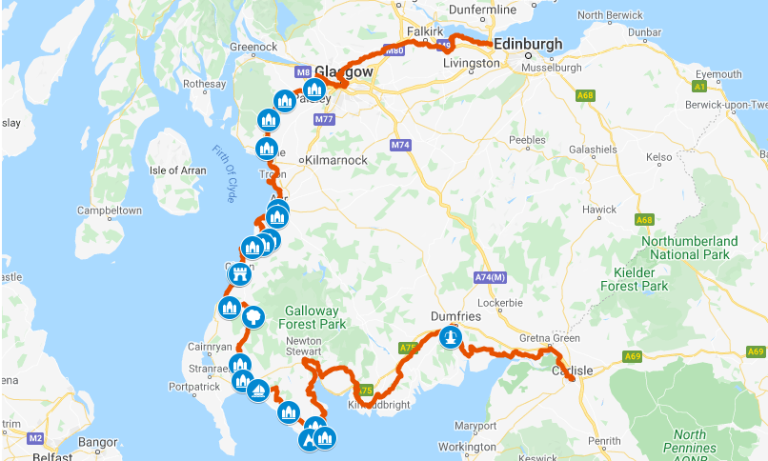
St Ninian’s Way
From Carlisle Cathedral to Queensferry (Edinburgh)
Walking distance: 250 miles

Slide 19
What is the difference between a pilgrimage and a holiday?

Slide 20
What is the difference between a physical and spiritual journey?

Slide 21
How has pilgrimage changed from 4th century to present day?

Slide 22
Pilgrim Badges

Slide 23
This scallop shell badge is a symbol of St James and associated with the pilgrimage to Santiago De Compostela.
Made in Spain and found in London.
Likely from the 12th-16th Century.
The Universal sign of pilgrimage.
© British Museum
https://www.britishmuseum.org/collection/object/H_1856-0701-2106

Slide 24
Date: 1425-1475
Location: England
From the Shrine of St Thomas Becket at Canterbury Cathedral.
An altar was set up on the precise spot where Becket was killed and the weapon itself was shown there.
These pilgrim badge swords were popular in the 14th and 15th Century.
© British Museum
https://www.britishmuseum.org/collection/object/H_2001-0702-7

Slide 25
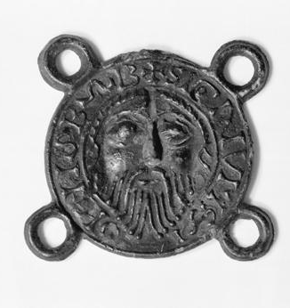
This Pilgrim badge shows the head of John the Baptist.
It is likely to have been sold as a souvenir at the Shrine of John the Baptist in Amiens Cathedral in France.
The four rings allow people to sew the badge on to a hat or cloak.
This badge was found in Perth, Scotland. Perth has the highest number of pilgrim badges found in Scotland.
© Perth Museum and Art Gallery
https://www.bbc.co.uk/ahistoryoftheworld/objects/nMwqDkEfSV6DUUEldDLCXA

Slide 26
Date: Early 14th Century
Location: England
Inscription says ‘mother’
Two standing figures beneath an arched canopy.
The woman is wearing a crown, her right hand extended out whilst her left hand is holding a stick/rope.
The man leans towards her with his arms outstretched.
© British Museum
https://www.britishmuseum.org/collection/object/H_1856-0701-2096

Slide 27
Labyrinth Tile

Slide 28
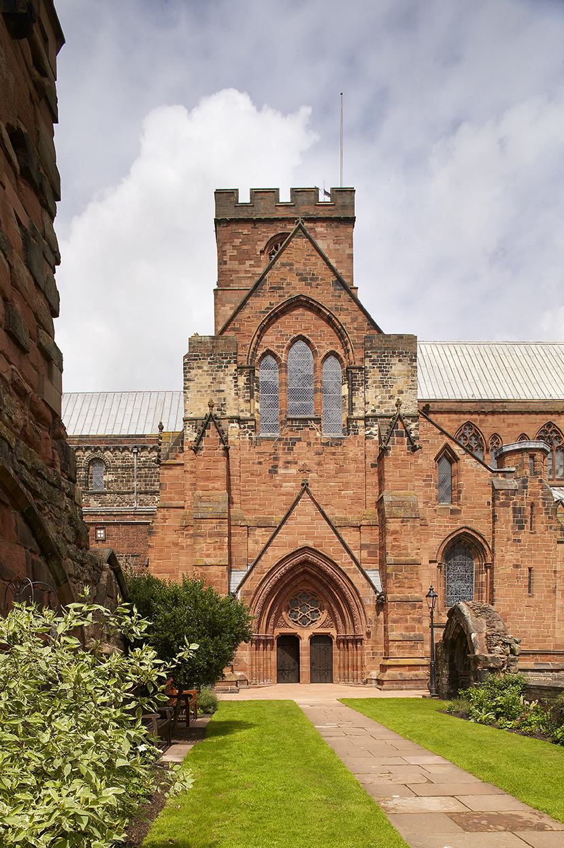
Carlisle Cathedral is celebrating its 900 year centenary this year! And we would like your school to help to create a HUGE labyrinth.​
The labyrinth will be used in the celebrations; many children will make the journey through it and lots of visitors will see it too. ​
Your School Tile….What will you include to make children from other schools and visitors know that this tile was created by You?!​

Slide 29
What is a labyrinth?​

Slide 30
What could you include in your school tile?
School Badge Values
Motto Locations and Journeys
Environment School day

Slide 31
Complete the ‘My School, My Journey’ worksheet
Include lots of drawings and colour.

Slide 32
Once your idea sheets are finished, spread them out for the whole class to see. Look at what everyone has drawn. What themes and ideas do you like best?
Remember, this is about what is unique about your school.

Slide 33
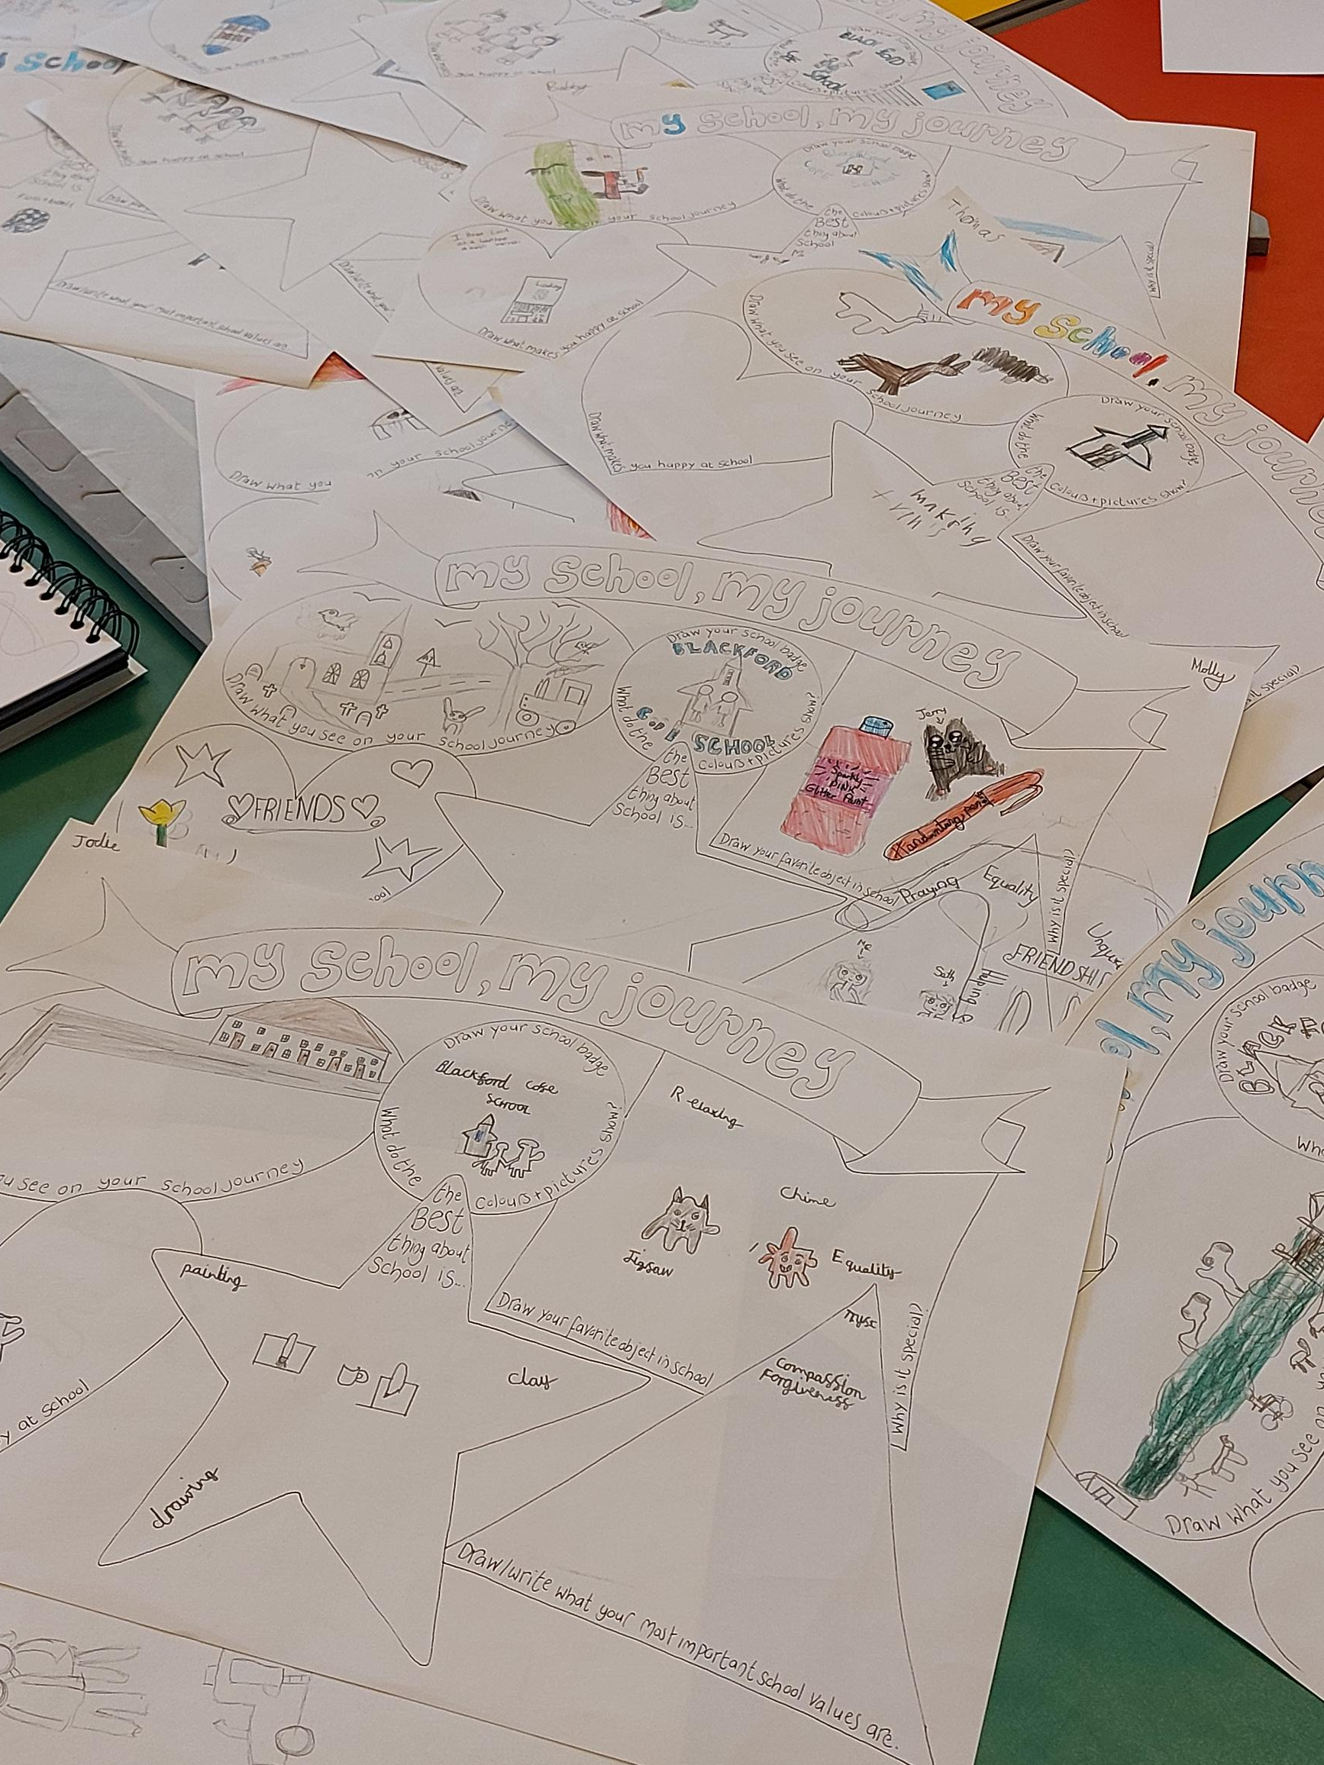
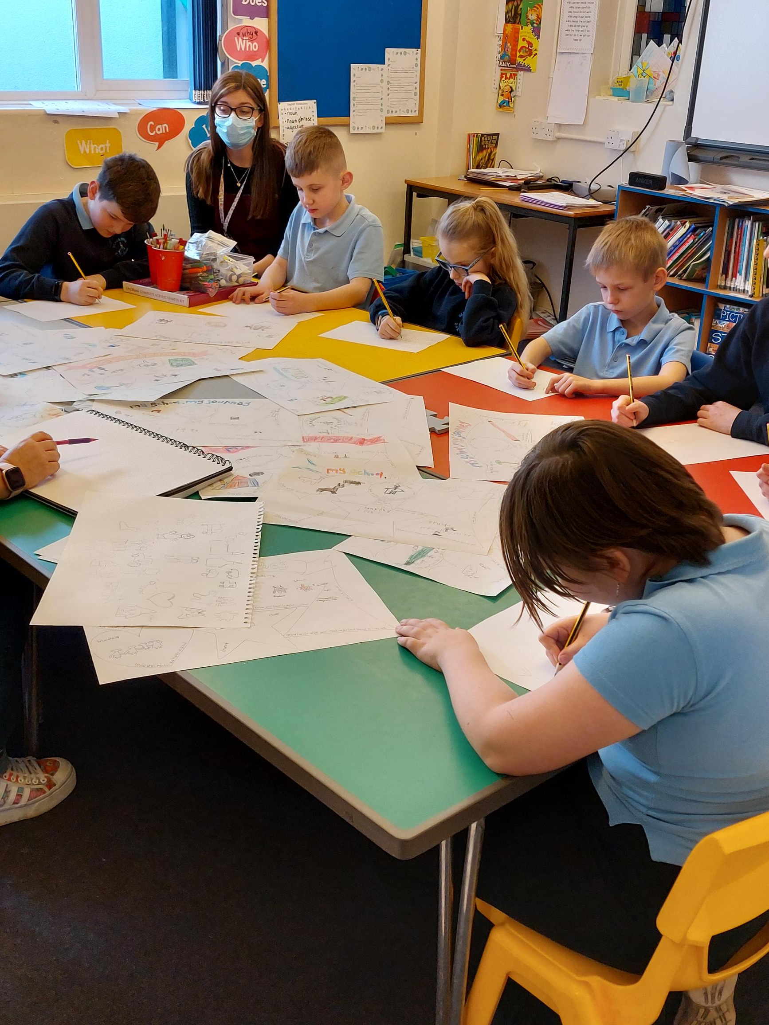
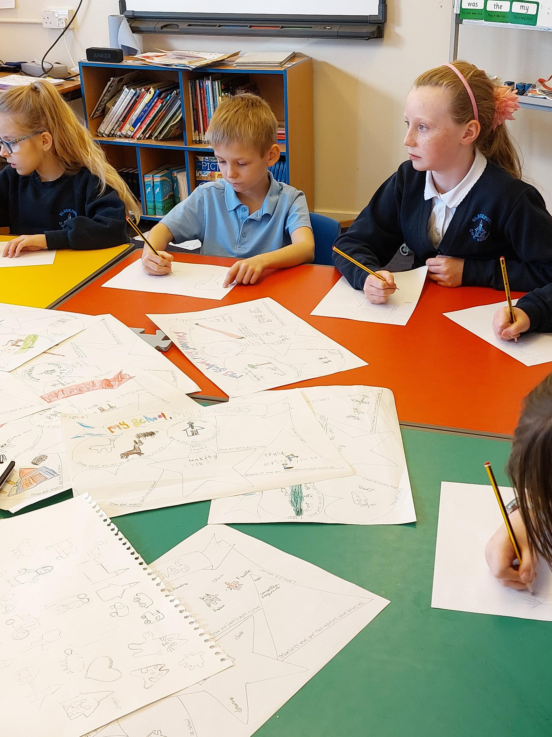
The next step. In a smaller group start to develop ideas from the class sketches and discussions. Consider what images and ideas you want on your tile, including layout and colour schemes. ​

Slide 34
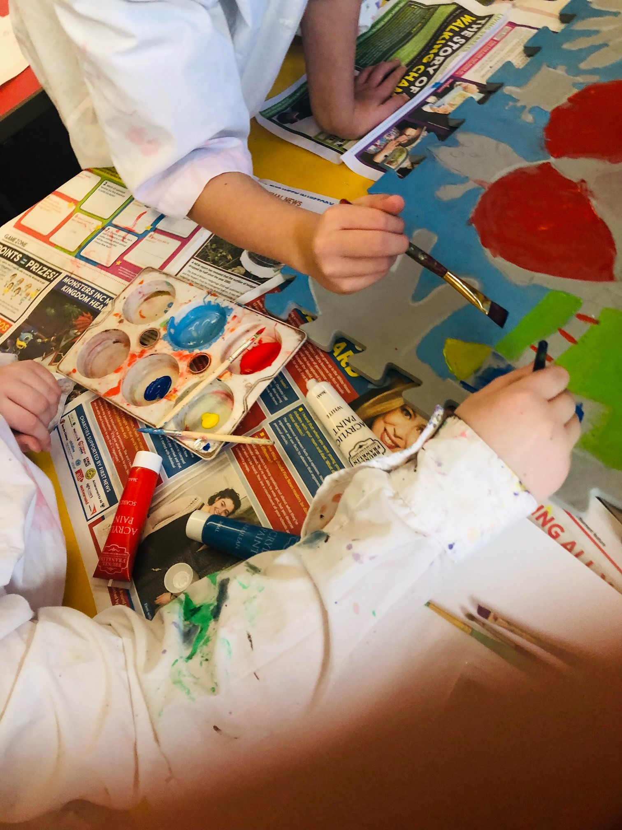
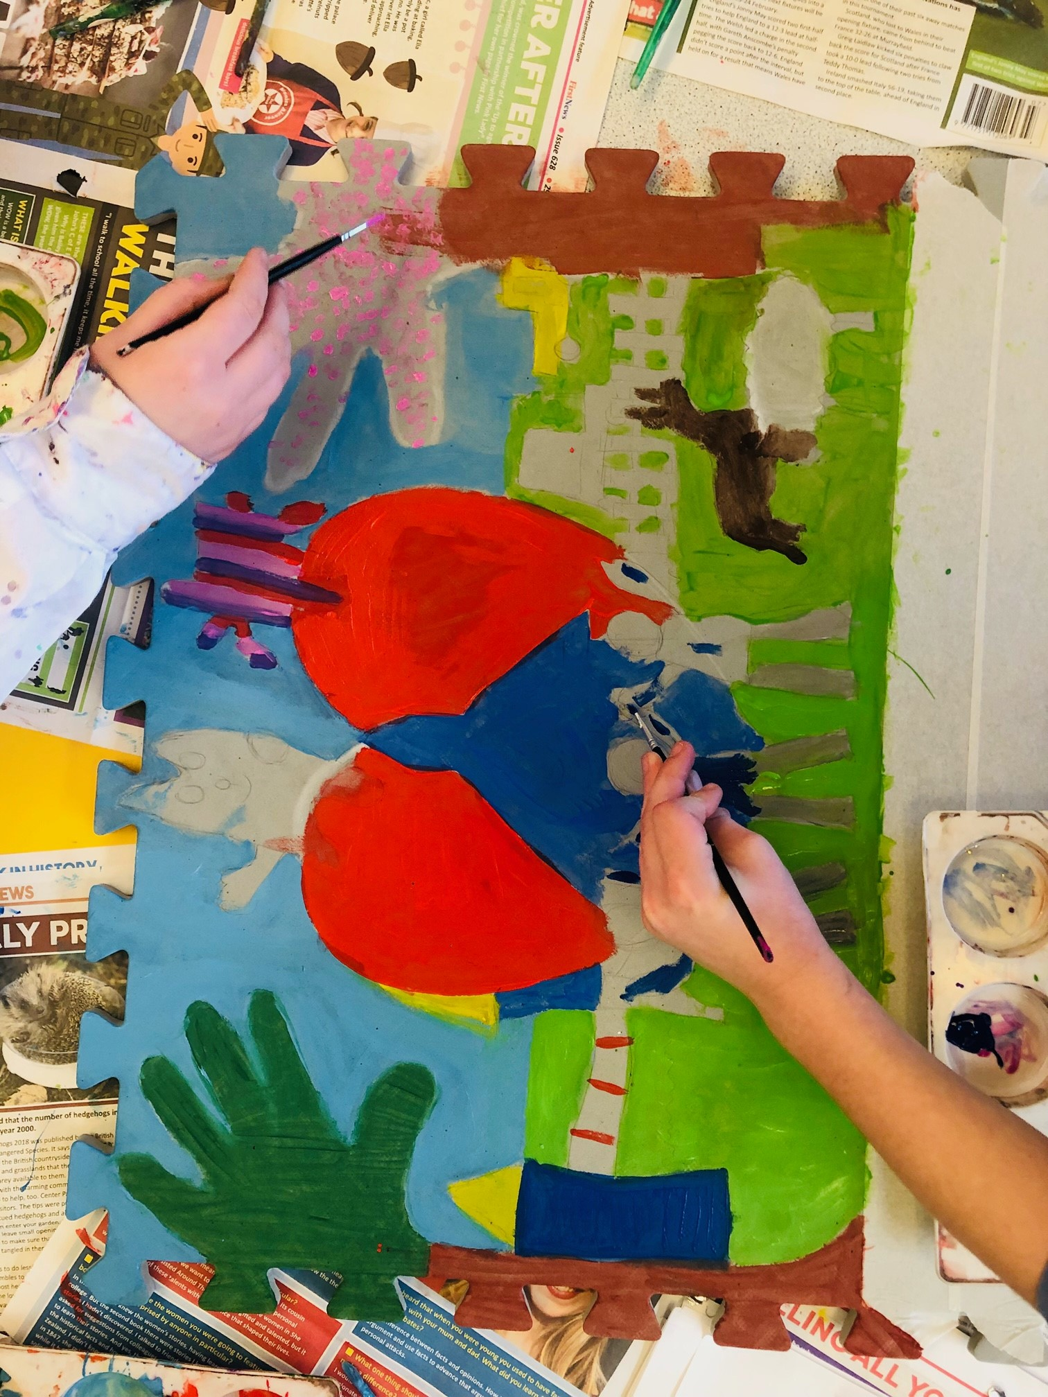
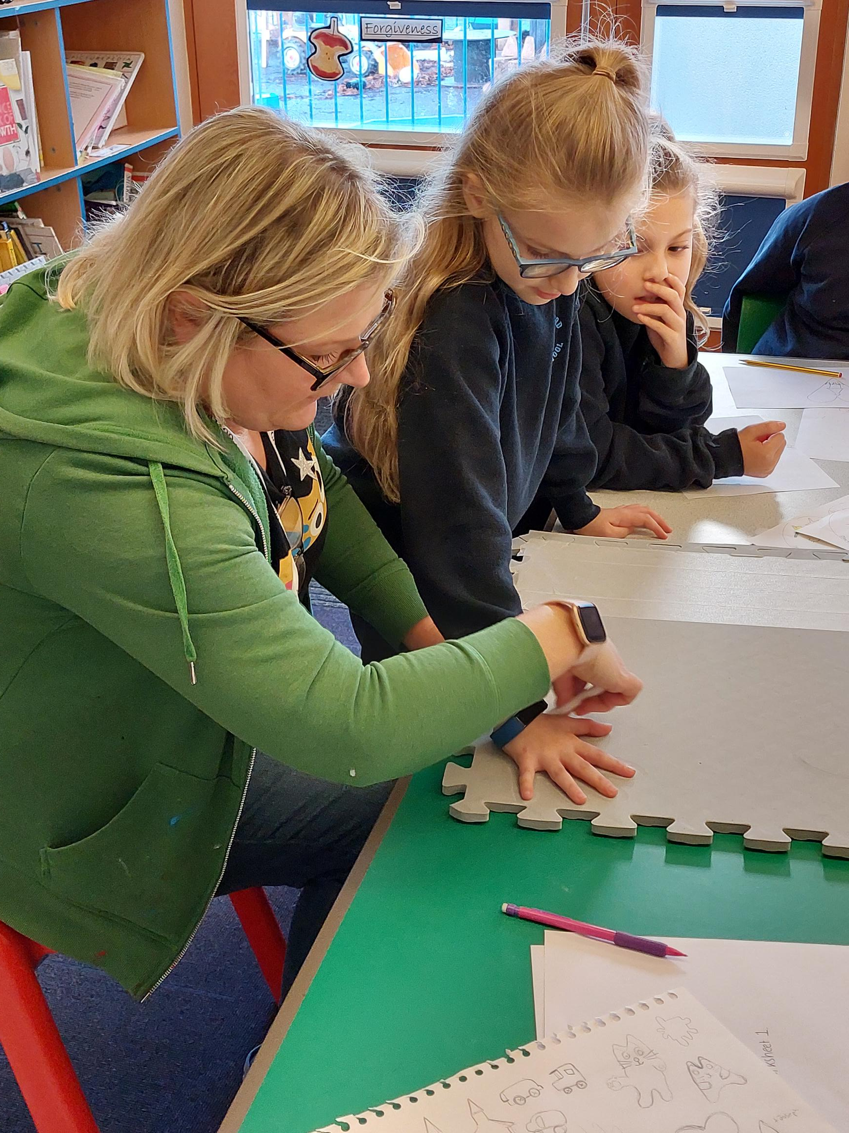
Lightly sketch your final design onto the tile and begin to paint. It may take a few layers of paint to make the colours stand out on your tile.

Slide 35
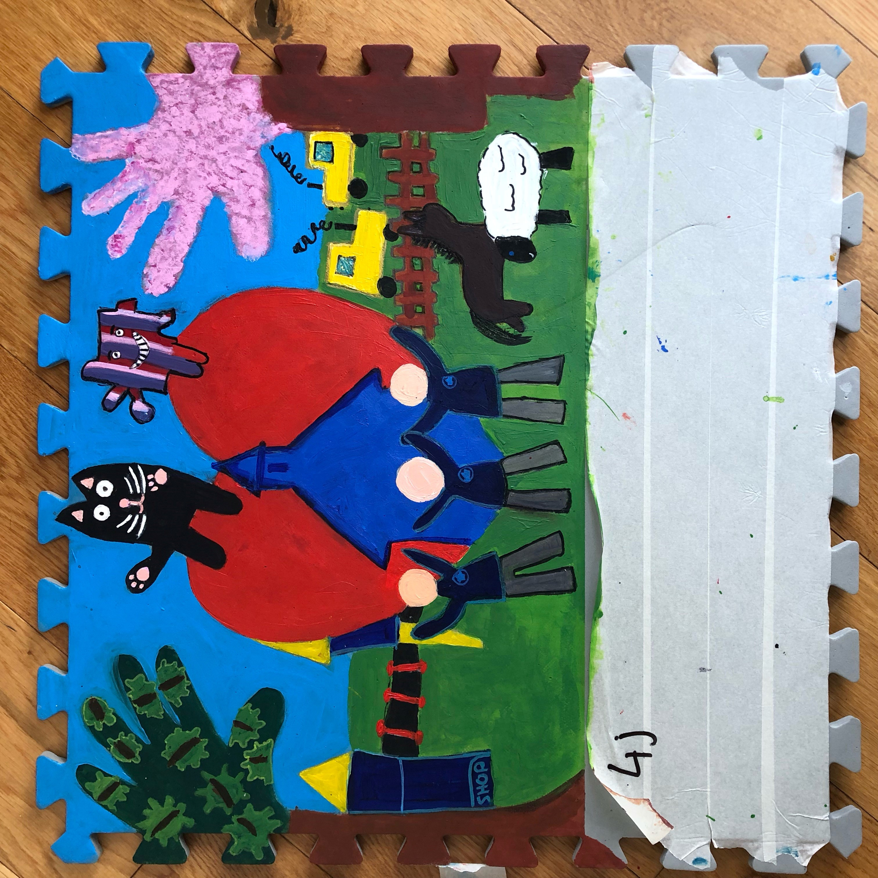
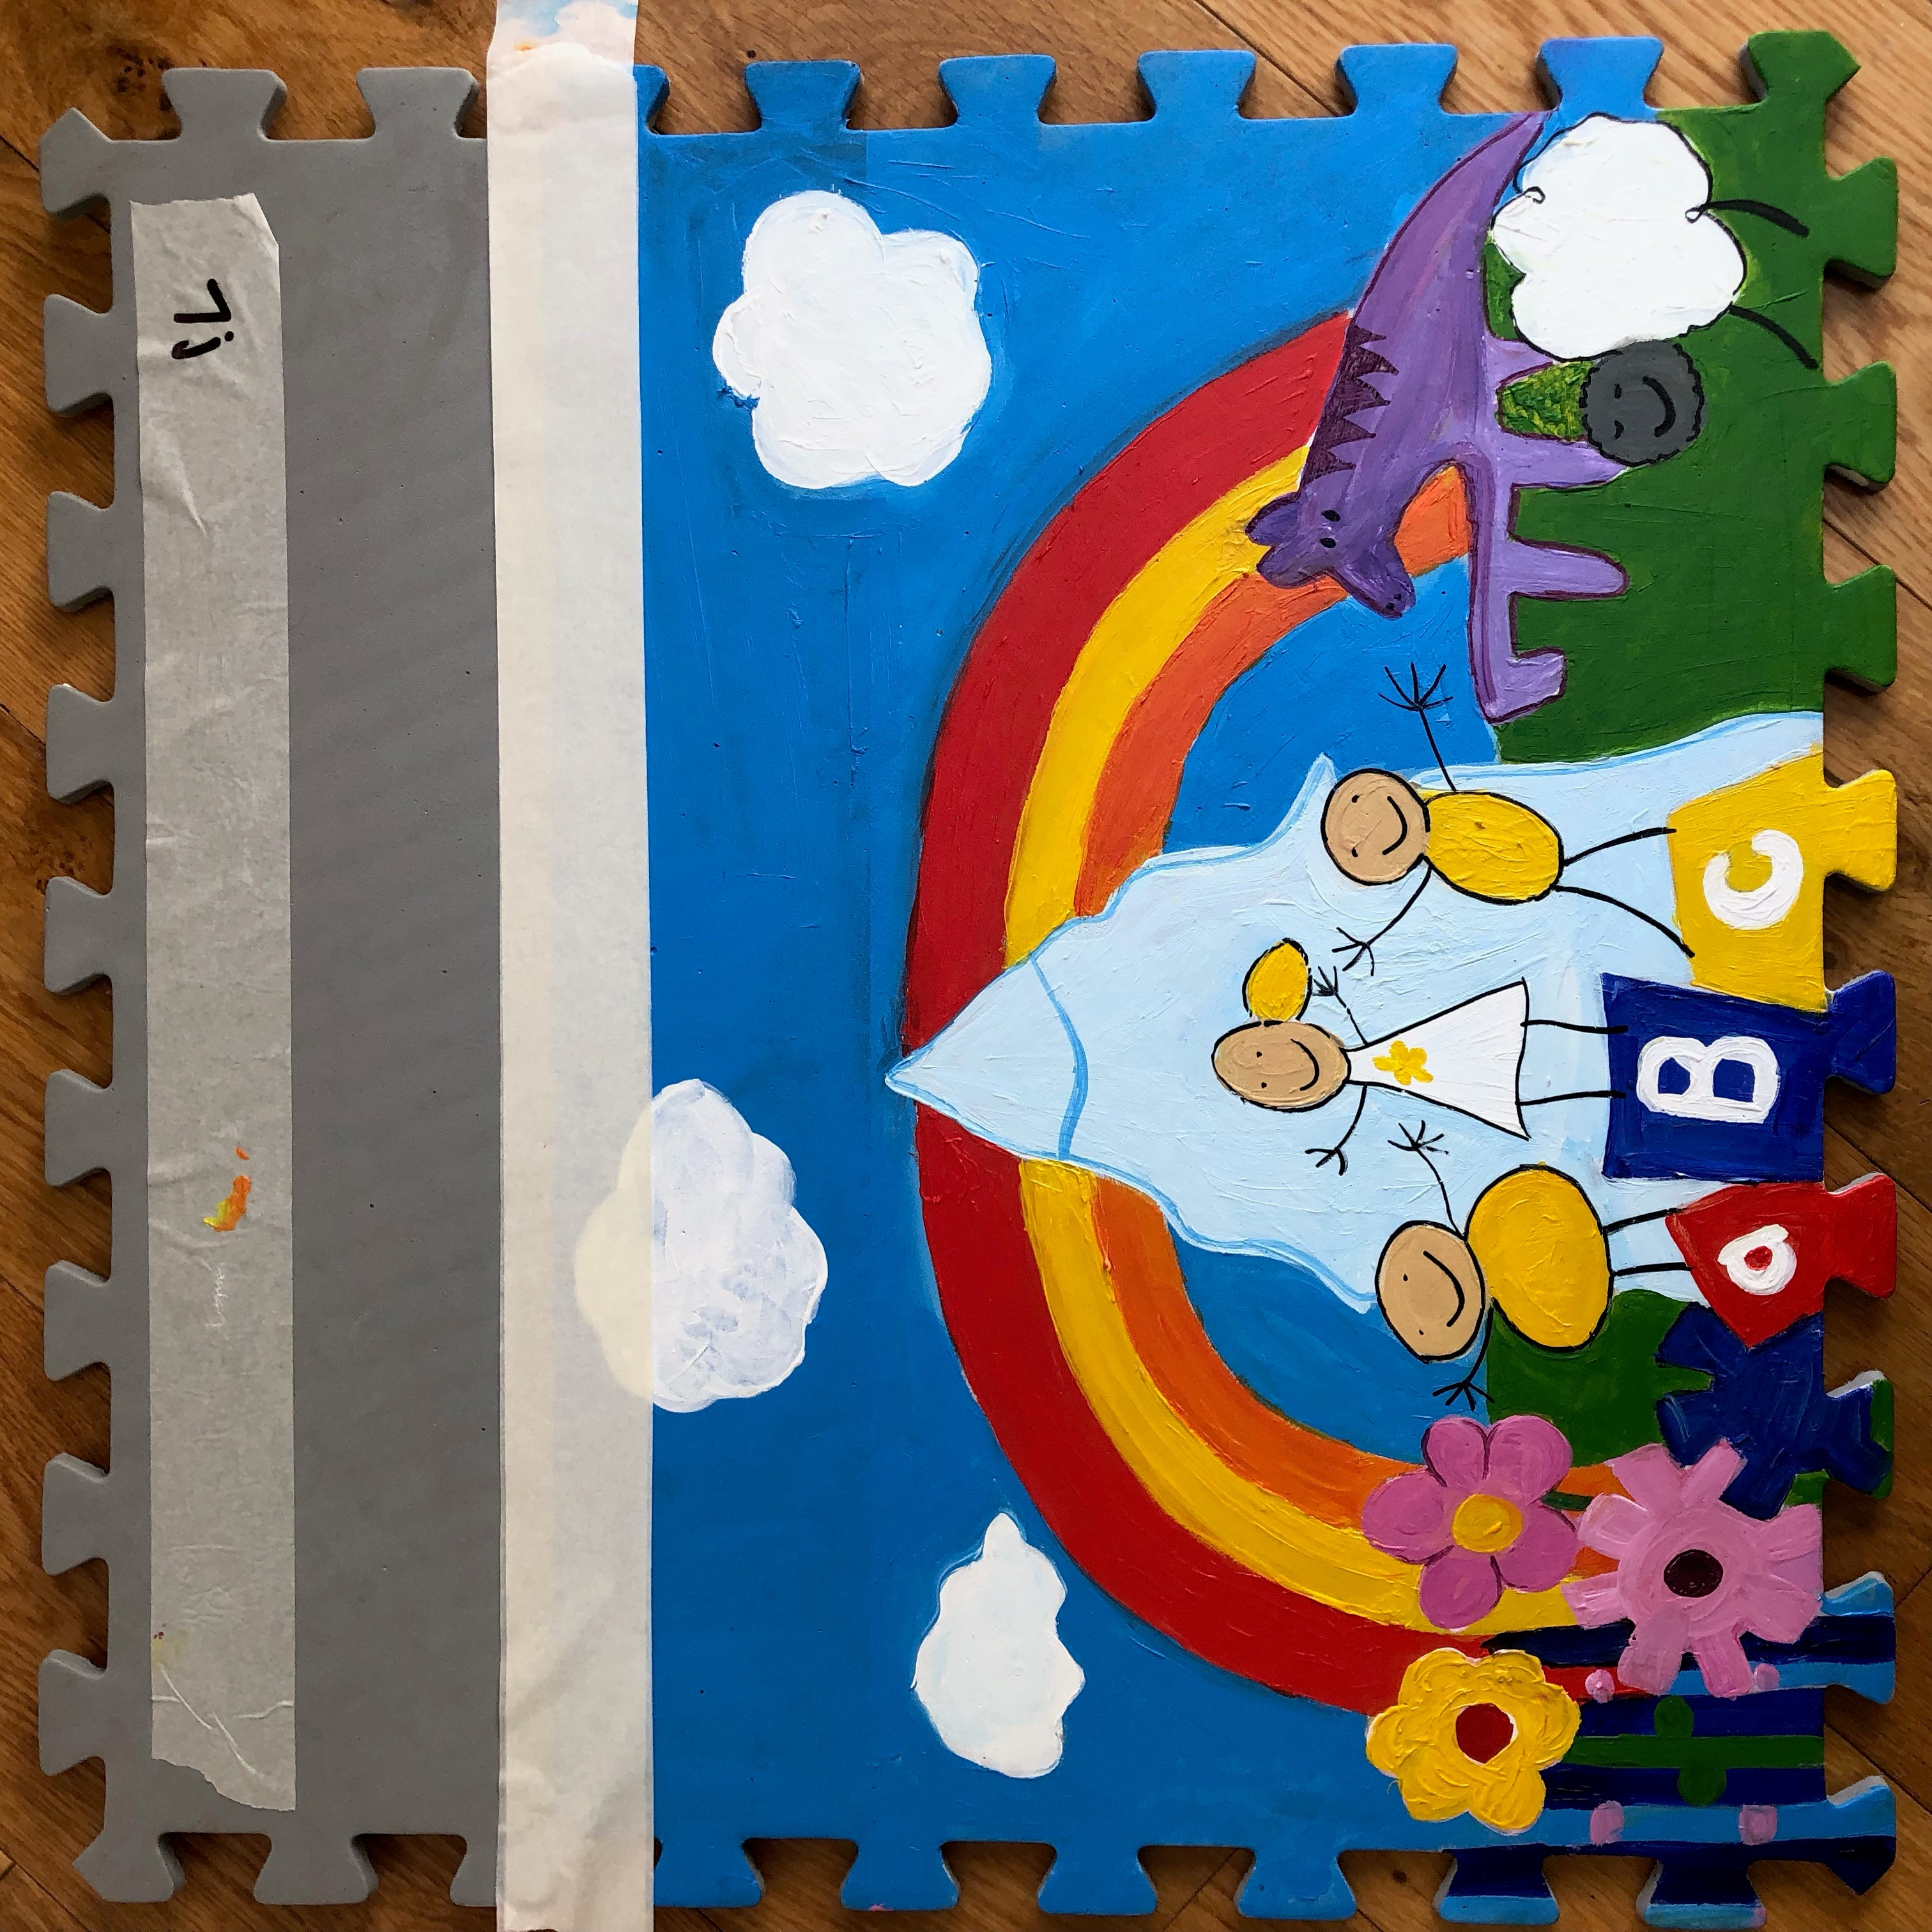
Blackford CofE Primary Schools final tiles.
Remember, your tile can look very different to this. It is about what is unique to your school!

Slide 36
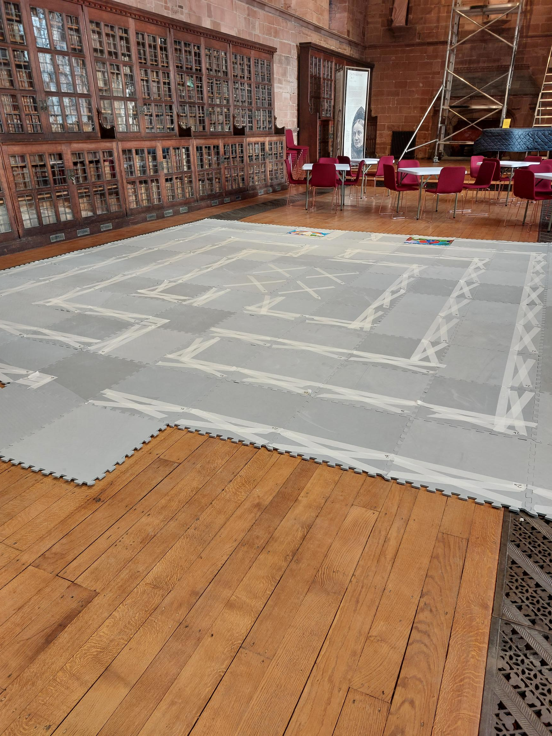
The Labyrinth will be displayed in Carlisle Cathedral’s Fratry Hall.

