Slide 1
Relationships Education and Sex Education
Consultation with families

Slide 2
Aims of the meeting
To find out more about the new guidance (which is compulsory from September).
To understand what the school currently teaches in Relationships Education and Sex Education.
To explore together what, if anything, should be changed.
To have a chance to ask questions.
Some conversations during this meeting may be very sensitive or personal and we request that you keep confidential anything shared by another parent or family member.
This Photo by Unknown Author is licensed under CC BY-SA-NC

Slide 3
Why is there new guidance on Relationships Education & Sex Education?
The Department for Education’s guidance for schools in this area was last updated in 2000 and no longer reflects the modern digital and social media world we now live in.
The new guidance has caught up with what we are already teaching our pupils: that they are unique, cherished and special; what it means to belong to a loving family and a caring school community; what it means to be a good friend; that diversity is important and to be valued; how to use social media and the internet safely and responsibly; how to keep themselves and others safe and healthy (physically and emotionally) and where to find help when needed.
We spend a lot of time in school supporting our pupils’ emotional and mental wellbeing (as well as their academic learning). The new guidance recognises the importance of this including reducing the stigma associated with mental health issues.

Slide 4
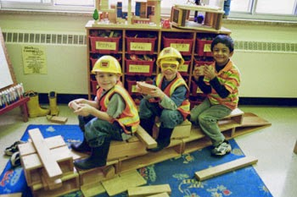
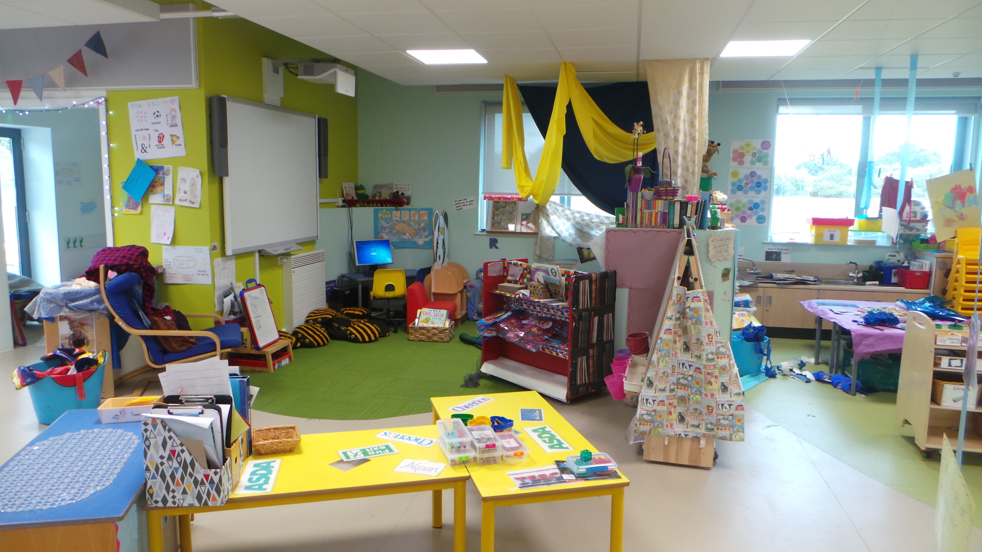
Relationships Education at our school?
We begin teaching Relationships Education from the first moment our pupils walk through the door.
Here are just some of the things our pupils learn about healthy relationships on their first day at school …
How to listen to one another;
How to share our school’s resources;
How to play well together and ensure no one is left out;
How to look after the environment around us (the school and the wider world);
That every class member is as important as everyone else;
How to disagree well with each other (being curious about difference, accepting and respecting different backgrounds and ways of life);
How to look after each other (e.g. getting an adult if someone falls down) and
That family members love each other even when they are apart.
This Photo by Unknown Author is licensed under CC BY-NC-ND
This Photo by Unknown Author is licensed under CC BY
This Photo by Unknown Author is licensed under CC BY-SA-NC

Slide 5
Statutory expectations by the end of EYFS
The Early Years Foundation Framework contains several explicit references to expectations for Relationships Education in its Physical Development; and Personal, Social and Emotional learning goals:
“Know the importance for good health of physical exercise and a healthy diet, and talk about ways to keep healthy and safe and manage their own basic hygiene and personal needs successfully, including dressing and going to the toilet independently”. (ELG 5)
“Play co-operatively, taking turns with others; take account of one another’s ideas about how to organise their activity; show sensitivity to others’ needs and feelings, and form positive relationships with adults and other children”. (ELG 8)
This Photo by Unknown Author is licensed under CC BY-NC-ND
This Photo by Unknown Author is licensed under CC BY
This Photo by Unknown Author is licensed under CC BY-SA-NC

Slide 6
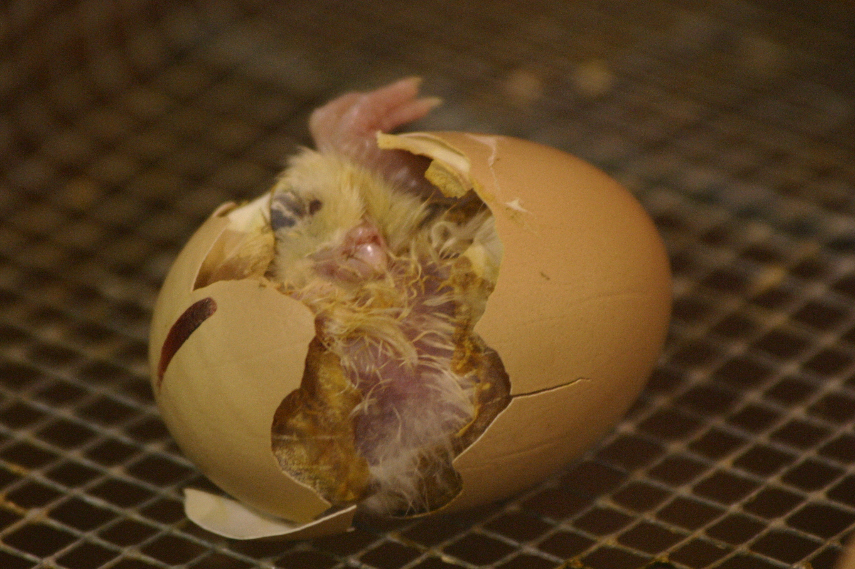
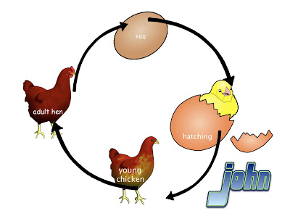
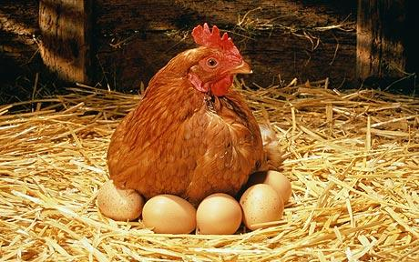
Statutory expectations by the end of Key Stage 1
The National Science Curriculum requires that, “Pupils should be taught to:
Notice that animals, including humans, have offspring which grow into adults
Find out about the describe the basic needs of animals, including humans, for survival (water, food and air)
Describe the importance for humans of exercise, eating the right amounts of different types of food, and hygiene.
Work in Key Stage 1 focuses on life cycles (e.g. egg, chick, chicken; baby, toddler, child, teenager, adult).
This Photo by Unknown Author is licensed under CC BY-NC
This Photo by Unknown Author is licensed under CC BY-SA
This Photo by Unknown Author is licensed under CC BY-ND

Slide 7
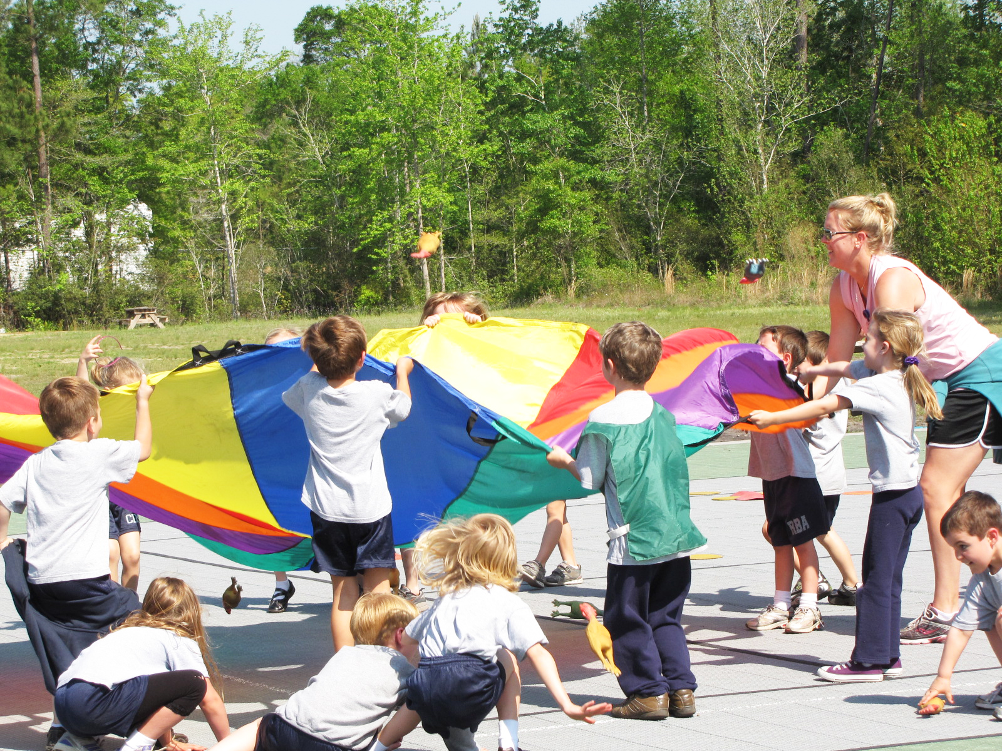
What else do we already teach in Key Stage 1?
During our PE sessions, we cover many of the requirements of the new guidance.
We encourage our pupils to understand the importance of:
their own physical health and hygiene (including exercise, diet, looking after their bodies and teeth and sleep hygiene); and
their relationships with others (including playing as part of a team, the importance of following the rules and being a good sport and gracious loser).
Though our PSHE sessions, RE lessons, acts of Collective Worship and our circle time sessions [schools should insert here any other school activities which promote relationships education] we build on the work begun in Early Years. We support our pupils in being good global citizens, looking after our world and respecting and valuing their classmates. We encourage pupils to reflect on relationships which have broken down and how they could be repaired. We celebrate difference and diversity and instil curiosity and inquisitiveness in our pupils who we encourage to ask and answer “big” questions.
Where behaviour falls short of our high expectations, we work with our pupils to change their behaviour, recognising that it results from their own misunderstanding, personal circumstances or experiences.
This Photo by Unknown Author is licensed under CC BY-SA

Slide 8
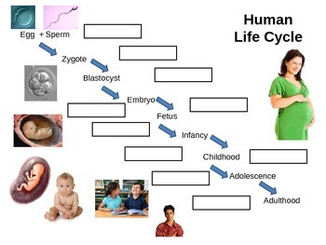
Statutory expectations by the end of Key Stage 2
The National Science Curriculum requires that, “Pupils should be taught to:
Describe the differences in the life cycles of a mammal, an amphibian, an insect and a bird
Describe the life processes of reproduction in some plants and animals
Describe the changes as humans develop to old age
The non-statutory guidance makes clear that by the end of Year 5, there is an expectation that pupils will have a good understanding of the mechanics of puberty and sexual reproduction.
This Photo by Unknown Author is licensed under CC BY-NC-ND

Slide 9
What else do we already teach in Key Stage 2?
During Key Stage 2, we prepare our pupils for the next stage in their education, encouraging them to become increasingly independent and reflective. Pupils are expected to take more responsibility for their actions and to reflect on and develop their own system for reparation and rebuilding of broken relationships.
Our pupils are given increased responsibility [you may wish to include some of the responsibilities given to pupils e.g. Worship Leaders, School Captains, School Council, Eco Leader etc]
PE sessions encourage pupils to achieve their personal best.
There is increased focus on being good global citizens, building on the work in Key Stage 1. Pupils are beginning to think about their goals and aspirations and the steps necessary to achieve their dreams.
The role of the internet, social media and what it means to say things online rather than face to face are explored in detail and pupils are encouraged to consider the implications of their online activities on their own reputation and the impact their actions have on others.
This Photo by Unknown Author is licensed under CC BY-NC-ND

Slide 10
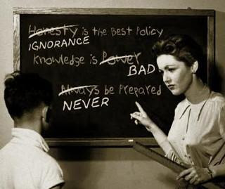
Sex Education at our school
We understand the sensitivity around this subject for parents.
Many of the staff at our school are also parents.
It is not an easy thing to talk about or to have to think about our children knowing about.
However, we know that ignorance in this area means it is more likely that pupils will: ask their friends and get misinformation; turn to the internet and find images that are distressing; become prematurely sexually active; have unwanted pregnancies or contract sexually transmitted infections.
We know it is difficult. We don’t enjoy teaching it, but we know it is in the best interests of our pupils that they find out the facts from us before something worse happens.
This Photo by Unknown Author is licensed under CC BY-SA

Slide 11
When do we currently teach Sex Education?
Like other schools, we currently teach our pupils about the changes to their body including (for girls) about periods during [Year 5].
As a loving and supportive Christian school, we do not want any pupil to feel frightened by the changes taking place to their body. Nor do we want the lack of sanitary products to be a cause of embarrassment or a barrier to learning. We therefore make all our pupil aware of the ready supply of sanitary products available at school and how to obtain access to them without embarrassment.
Equally, like many other schools in the County, we teach Sex Education to our pupils during [Year 6] as part of their transition to secondary school. We do not want pupils to enter an environment which they will share with much older pupils, some of whom may be sexually active, without being clear on the facts and able to ask questions in a safe and comfortable environment.
Understanding what is and is not acceptable in relation to their bodies puts our pupils in a position of strength and enables them to identify if someone is attempting to cross boundaries inappropriately. We also teach our pupils where to get help if they need to.

Slide 12
Removing a pupil from lessons
It is not possible to ask to withdraw a pupils from Relationships Education.
You can ask to withdraw your child from Sex Education sessions.
We do not recommend doing so. It is better for pupils to have the facts rather than asking a friend or looking online. Just because a child isn’t in the sessions, doesn’t mean they won’t find out about sex.
We will keep you fully informed so that you know exactly when Sex Education sessions will take place.
If you would like to discuss the content of the sessions or the materials and resources used, please speak to [your child’s class teacher].
If you do wish to withdraw your child from Sex Education sessions, you should [set out the procedure in your school e.g. make an appointment to speak to the Headteacher who will discuss this with you].
This Photo by Unknown Author is licensed under CC BY-SA

Slide 13
Over to you …
Now you know what currently happens, we would like to hear your suggestions.
There are three stations around the room where there will be a member of staff [or governor] to help you.
At each station you will find a question:
What are your fears about the teaching of Relationships Education, Sex Education and Health Education in our school?
What do you really want your child to know about Relationships, Sex and Health AND when do you want them to learn each of these things?
What would you change about how the school currently teaches Relationships Education, Sex Education and/or Health Education?
Please make a note of your thoughts on a ‘post-it’ note and add it to the station.
We will come back together in 15 minutes to discuss what people have suggested.

Slide 14
Working with families
We fully recognise the importance of a partnership with families in supporting our pupils and we are grateful for your input today.
We will look at all of your comments when we write our draft policy.
We will send out a draft policy document and you will be invited to comment on it or make further suggestions.
When we work together, children hear the same message at school and at home.
We are grateful for your support.
This Photo by Unknown Author is licensed under CC BY-NC

Slide 15
How can we help you?
We understand that talking about health issues, body issues, mental wellbeing, relationships issues, sexual health and what to do if your child has concerns can be extremely difficult for parents.
We are here to help.
If you have any concerns or need any support please make an appointment to speak to: [you should name your school’s designated PSHE lead, wellbeing lead, Headteacher or DSP as appropriate for your school and give relevant contact details]

