Slide 1


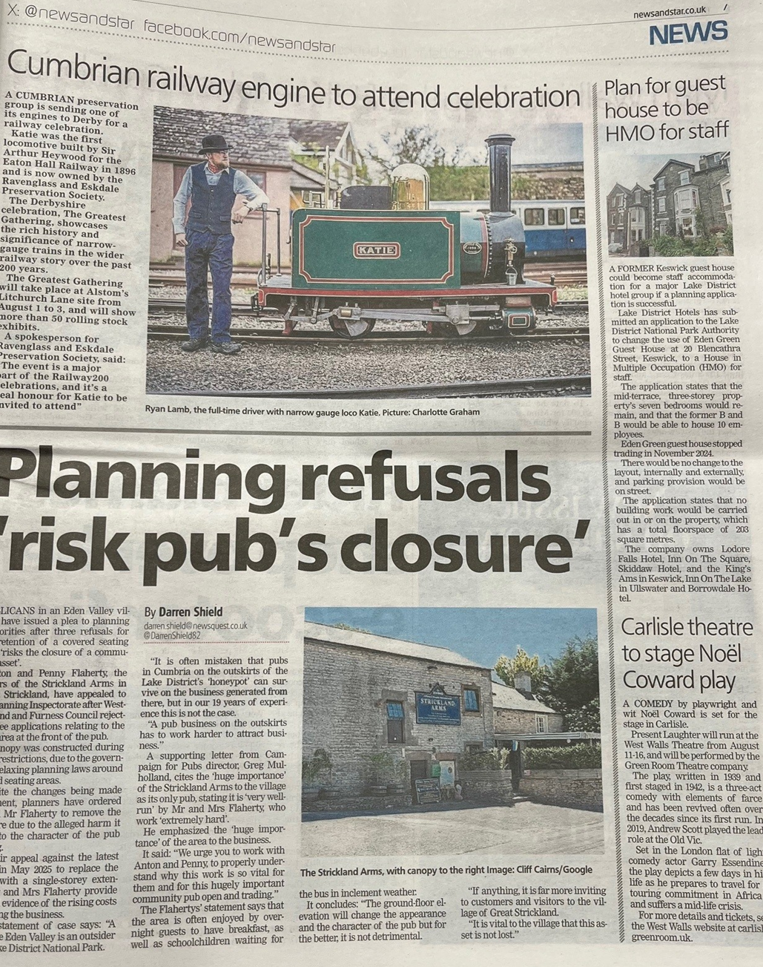

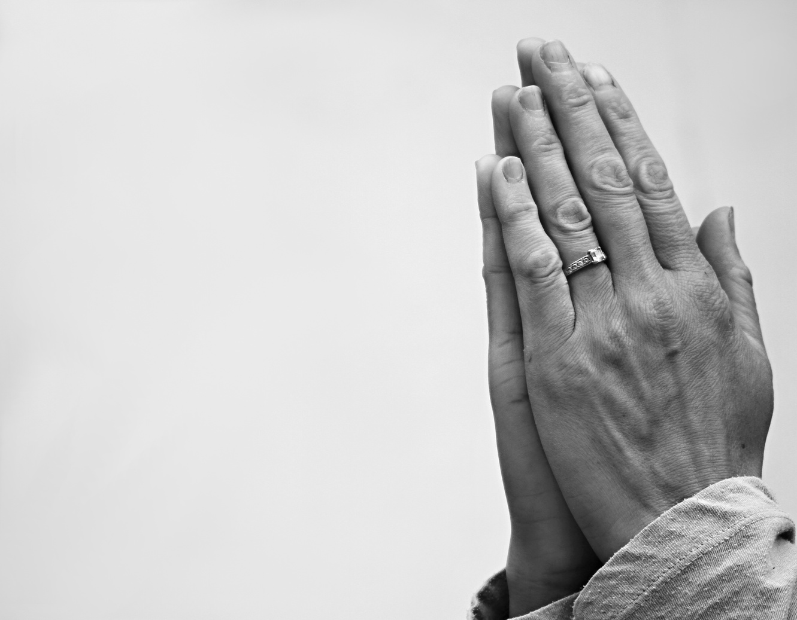
EXPLORING
your call
PRAYING THE PEOPLE’S PRAYERS: Leading Intercessions in worship

Slide 2

What are we doing when we lead prayers in worship?
How to write prayers
Praying with the news
Resources for intercessions

Slide 3
What are we doing when we lead prayers in worship?

Slide 4






What are we doing when we lead prayers in worship?

Slide 5

What are we doing when we lead prayers in worship?
To the
Father
Through the
Son
By the power of the
Holy Spirit

Slide 6
What are we doing when we
lead prayers in worship?
What do we pray for?

Slide 7
What are we doing when we
lead prayers in worship?
A common pattern
Strengthen N our bishop and all your Church in the service of Christ, that those who confess your name may be united in your truth, live together in your love, and reveal your glory in the world.
Bless and guide Charles our King; give wisdom to all in authority; and direct this and every nation in the ways of justice and of peace; that we may honour one another, and seek the common good.
Give grace to us, our families and friends, and to all our neighbours, that we may serve Christ in one another, and love as he loves us.
Comfort and heal all those who suffer in body, mind, or spirit; give them courage and hope in their troubles; and bring them the joy of your salvation.
Hear us as we remember those who have died in the faith of Christ; according to your promises grant us with them a share in your eternal kingdom.
From https://www.churchofengland.org/prayer-and-worship
/worship-texts-and-resources/common-worship

Slide 8
What are we doing when we lead prayers in worship?
What do we pray for?
https://youtu.be/CHUerz4vGsY

Slide 9

What are we doing when we lead prayers in worship?
Ourselves and our communities
The world
The local community
Creation, human society, the Sovereign and those in authority
People in need
Those who suffer
The Church
Those who have died
The Church of Christ
The communion of saints

Slide 10
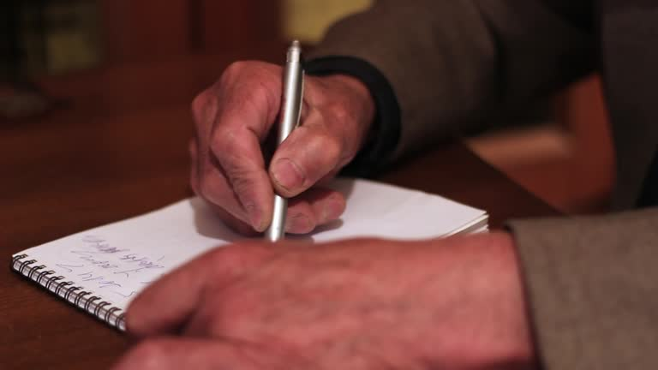
NH N
How to write prayers

Slide 11
How to write prayers
A common Anglican pattern: The Collect Form
The address to God: who we are talking to.
What God has done: where we have seen God at work, which is why we trust that God will listen and respond to our prayers.
The request: what precisely we plead with God to do.
The outcome: what we imagine it will look like when God answers our prayer
The conclusion: a reminder of how we access God, usually in Trinitarian form

Slide 12
How to write prayers
The Collect Form
The address to God
What God has done
The request
The outcome
The conclusion
Almighty God,
to whom all hearts are open, all desires known, and from whom no secrets are hidden:
cleanse the thoughts of our hearts by the inspiration of your Holy Spirit,
that we may perfectly love you, and worthily magnify your holy name;
through Christ our Lord. Amen.

Slide 13
How to write prayers
The Collect Form
The address to God
What God has done
The request
The outcome
The conclusion
✜
Almighty and everlasting God,
you have given us your servants grace,
by the confession of a true faith,
to acknowledge the glory of the eternal Trinity
and in the power of the divine majesty to worship the Unity:
keep us steadfast in this faith,
that we may evermore be defended from all adversities;
through Jesus Christ your Son our Lord,
who is alive and reigns with you,
in the unity of the Holy Spirit,
one God, now and for ever.
✜
✜
✜

Slide 14
How to write prayers
The Collect Form
The address to God
What God has done
The request
The outcome
The conclusion
✜
Holy God,
faithful and unchanging:
enlarge our minds with the knowledge of your truth,
and draw us more deeply into the mystery of your love,
that we may truly worship you,
Father, Son and Holy Spirit,
one God, now and for ever. Amen.
✜
✜
✜

Slide 15
How to write prayers
Try it for yourself…
Ourselves and our community
The address to God
What God has done
The request
The outcome
The conclusion
The world
People in need
The Church
Those who have died

Slide 16
How to write prayers
One person’s perspective
https://youtu.be/VXUhf3gMOKY

Slide 17
How to write prayers
Things to think about in preparation
Read the readings: almanac.oremus.org
Is there a theme in the service?
What specific things need prayer?
News (breadth)
Local issues and events
Special events : baptisms, weddings, funerals, major birthdays
People (but be aware of confidentiality)
Silence

Slide 18

Praying with the news

Slide 19


Praying with the news

Slide 20

Praying with the news
Leader: God is our refuge and strength,
All: a very present help in trouble. (Psalm 46)
Leader: Turn again, O Lord, and deliver my soul;
All: save me for your loving mercy’s sake. (Psalm 6)
Leader: Show us your mercy, O Lord,
All: and grant us your salvation. (Psalm 85)
Leader: O Lord, I call to you;
All: hear my voice when I cry to you.
(Psalm 142)

Slide 21
Resources for intercessions
The Book of Common Prayer 1662 | Traditional form of prayer
Common Worship: Main Volume | Standard prayers, with space to insert specific details
Common Worship: Daily Prayer | More standard prayers, with some seasonal variations
Common Worship: Times and Seasons | Prayers to use at particular times in the Church’s year
New Patterns for Worship | More ideas for creative prayer
https://www.churchofengland.org/prayer-and-worship/
worship-texts-and-resources/common-worship

Slide 22
Resources for intercessions
Morning or Evening Prayer or Service of the Word
The Book of Common Prayer 1662 | In service
Common Worship: Main Volume | 101, 111, 281
Common Worship: Daily Prayer | 360
Common Worship: Times and Seasons | Section H
New Patterns for Worship | 170
https://www.churchofengland.org/prayer-and-worship/
worship-texts-and-resources/common-worship

Slide 23
Resources for intercessions
Holy Communion
The Book of Common Prayer 1662 | In service
Common Worship: Main Volume | 281
Common Worship: Times and Seasons | Section H
New Patterns for Worship | 170
https://www.churchofengland.org/prayer-and-worship/
worship-texts-and-resources/common-worship

Slide 24
Resources for intercessions
Collects
The Book of Common Prayer 1662 | Before Holy Communion
Common Worship: Main Volume | 375, 448
Common Worship: Daily Prayer
Or find them at almanac.oremus.org
https://www.churchofengland.org/prayer-and-worship/
worship-texts-and-resources/common-worship

Slide 25
Resources for intercessions
Prayers for particular occasions
The Book of Common Prayer 1662 | After the litany
Common Worship: Main Volume | 101
Common Worship: Daily Prayer | 408
Common Worship: Times and Seasons | 593, 635
New Patterns for Worship | 408
Church of England website | https://www.churchofengland.org/prayer-and-worship/topical-prayers
https://www.churchofengland.org/prayer-and-worship/
worship-texts-and-resources/common-worship

Slide 26
Conclusion: What have you learned in this session?

Slide 27
Resources
Authorised resources
The Book of Common Prayer 1662. Cambridge University Press, 2024.
Common Worship: Times and Seasons. Church House Publishing, 2006
Common Worship Main Volume Standard Edition: Revised and Updated. Church House Publishing, 2024.
New Patterns for Worship. Church House Publishing, 2015.
https://www.churchofengland.org/prayer-and-worship/worship-texts-and-resources/common-worship

Slide 28
Resources
About leading intercessions
Chaplin, Doug. Leading Common Worship Intercessions: A Simple Guide. London: Church House Publishing, 2009.
Wells, Samuel. Crafting Prayers for Public Worship: The Art of Intercession. Norwich: Canterbury, 2013.

Slide 29
Resources
Collections of intercessions
Adam, David. The Complete Themed Intercessions. Buxhall: Kevin Mayhew, 2007.
Adam, David. Radiance of His Glory: Prayers for the Church Years A, B & C. London: SPCK, 2009.
Colquhoun, Frank. Parish Prayers. London: Hodder & Stoughton, 1967. http://assets.newscriptorium.com/ collects-and-prayers/parishprs.htm
Pritchard, John. The Intercessions Handbook: Creative Ideas for Public and Private Prayer. SPCK, 1997.
Pritchard, John. The Second Intercessions Handbook : More Creative Ideas for
Public and Private Prayer. London: SPCK, 2004.
For rural contexts: Seasonal Worship from the Countryside. London: SPCK, 2003.

Slide 30
Resources
Additional Resources
Thomas, Paul. Using the Book of Common Prayer : A Simple Guide. London: Church House, 2012.

